Slide 1
Chapter 1
Linear Equations in Linear Algebra
CS 223: Computational Linear Algebra
Based on Dr. Yasser Mohammad Seddiq slides
Modified as needed

Slide 2
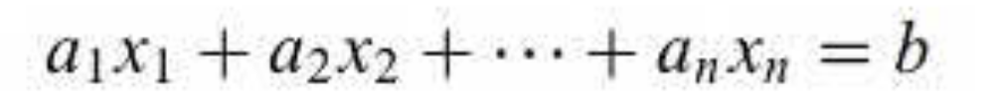
Systems of Linear Equations
A linear equation in variables x₁, x₂, …, x_{n} is the equation that can be written in the form
b and coefficients a₁, a₂, …, a_{n} are real or complex
n is positive integers

Slide 3
Systems of Linear Equations
Examples: linear equations:
Examples: Nonlinear equations:

Slide 4
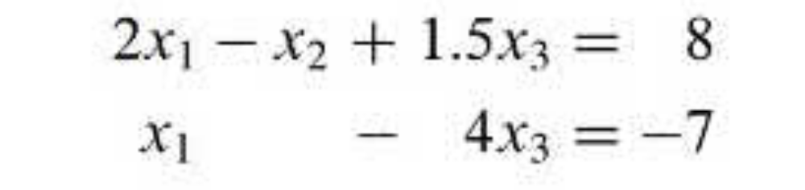
Systems of Linear Equations
A system of linear equations (linear system): is a collection of one or more linear equations involving the same variables x₁, x₂, …, x_{n}
The solution of the system s₁, s₂, …, s_{n} are the values that make the system equations true
In the example above, a solution is : 5, 6.5, 3
x₁, x₂, …, x_{n}

Slide 5
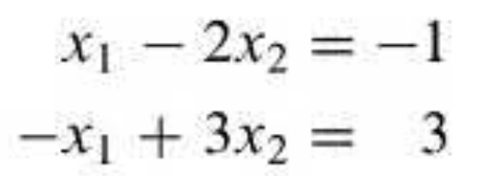
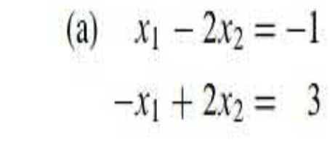
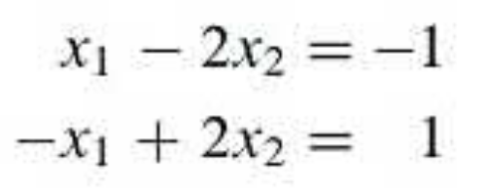
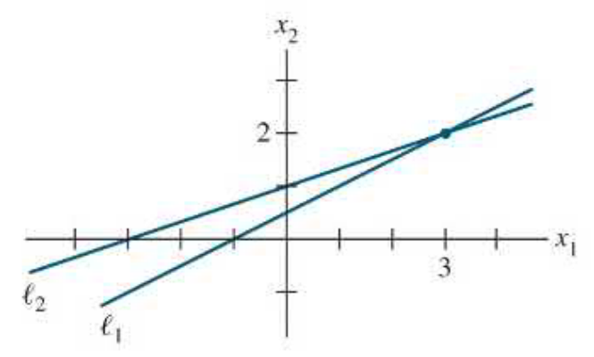
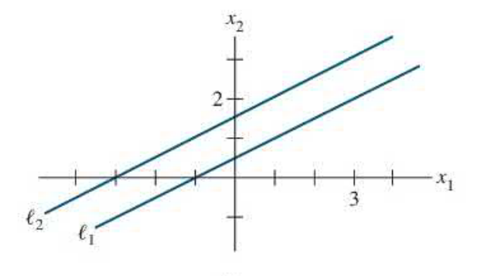
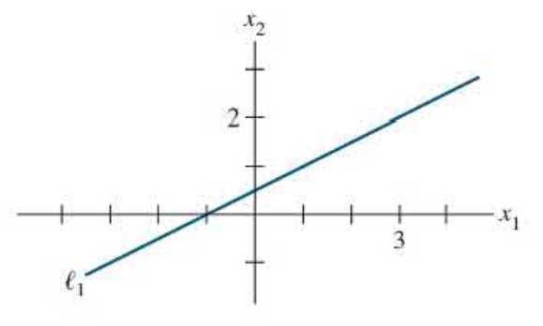
Systems of Linear Equations
The solution set: the set of all possible solutions of the linear system
Equivalent linear systems: two linear systems have the same solution set
has exactly one solution
has no solution
has infinitely many solutions
consistent
inconsistent
consistent

Slide 6
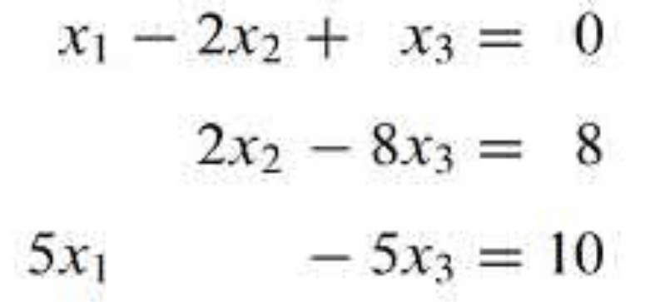
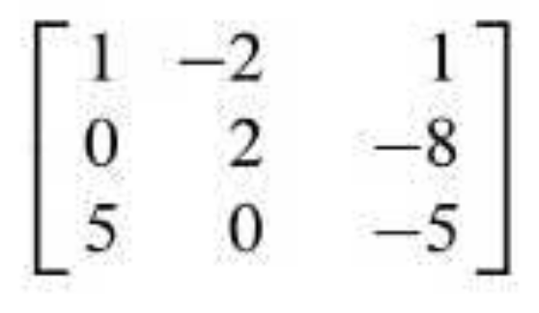
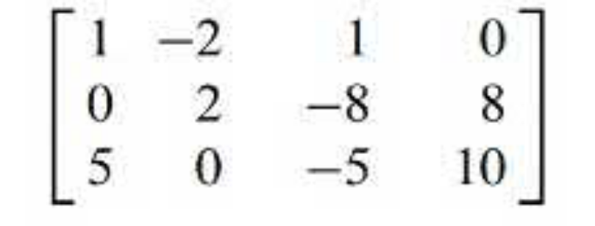
Systems of Linear Equations
Matrix notation:
Linear system
Coefficient matrix
m
rows
×
×
n
columns
Augmented matrix
3 × 4 matrix (rectangular array)

Slide 7
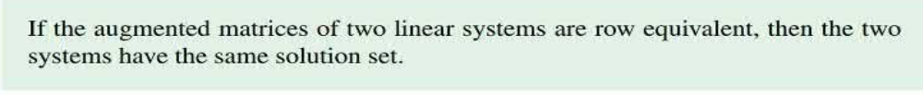
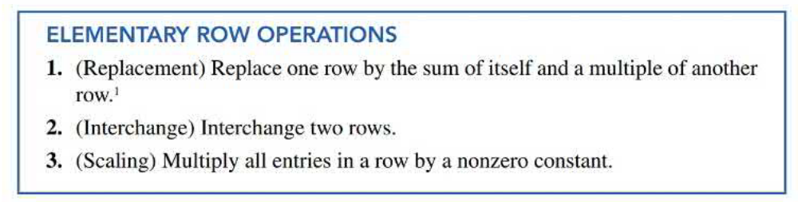
Systems of Linear Equations
Solving a Linear System: The basic strategy is to replace one system with an equivalent system (that is one with the same solution set) that is easier to solve.

Slide 8
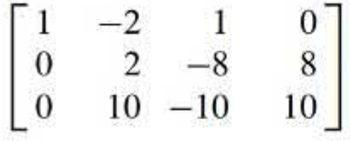
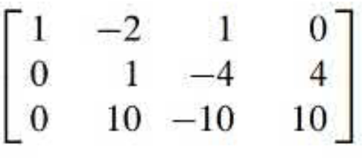
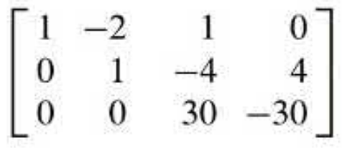
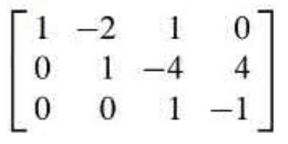
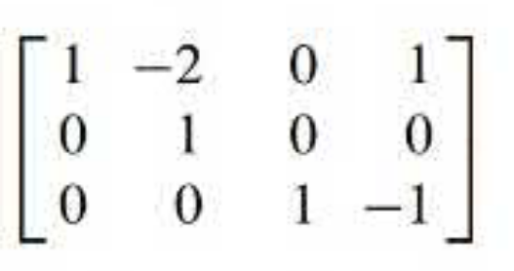
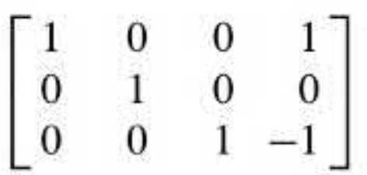
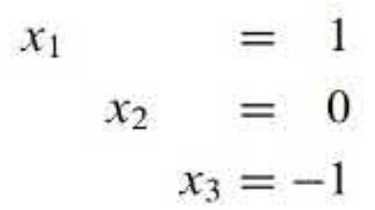

Example 1:
Solve the following system:
Augmented matrix
R3 = R3 – 5×R1
R2 = ×R2
R3 = R3 – 10×R2
R3 = ×R3
R1 = R1 – R3
R1 = R1 + 2×R2
System of linear equations
R2 = R2 + 4×R3
the only solution of the original system is
Finally, verify your work by substituting in the original equations
(x₁ , x₂ , x₃)

Slide 9
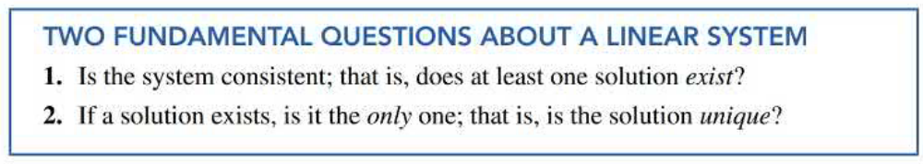
Systems of Linear Equations

Slide 10
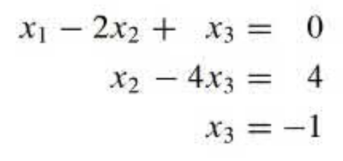
Example 2
Determine if the system is consistent
From eq (3), a solution of x₃ exists. Then, we substitute in eq (2) to solve x₂ . Then, substitute in eq (1) to solve x_{1..}
The solution of the system exists. Therefore, the system is consistent.
Augmented matrix
R3 = R3 – 5×R1
R2 = ×R2
R3 = R3 – 10×R2
System of linear equations

Slide 11
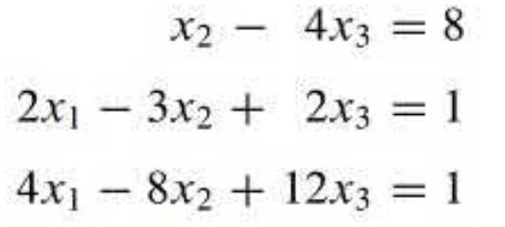
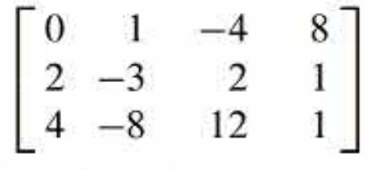
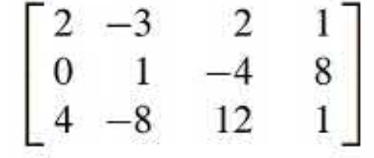
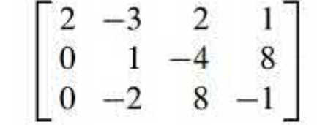
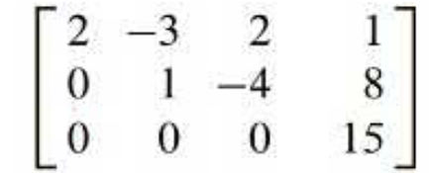
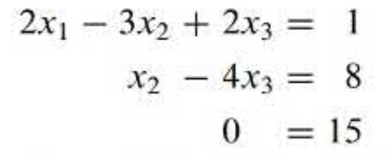
Example 3
Determine if the system is consistent
Therefore, the system is inconsistent (has no solutions).
Augmented matrix
R1 ←→ R2
R3 = R3 – 2×R1
R3 = R3 + 2×R2
This is never true

Slide 12
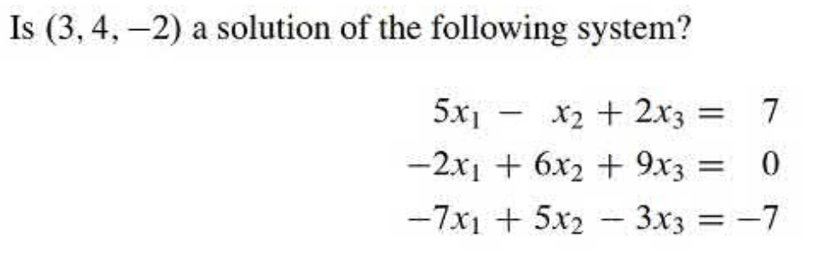
Exercise

Slide 13
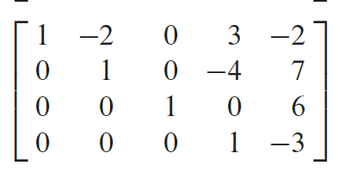
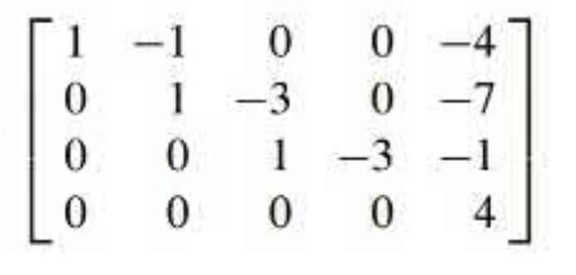
Exercise
Solve the following system:

Slide 14
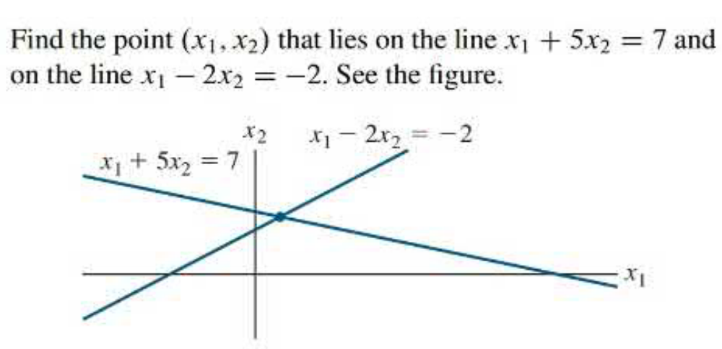
Exercise

Slide 15
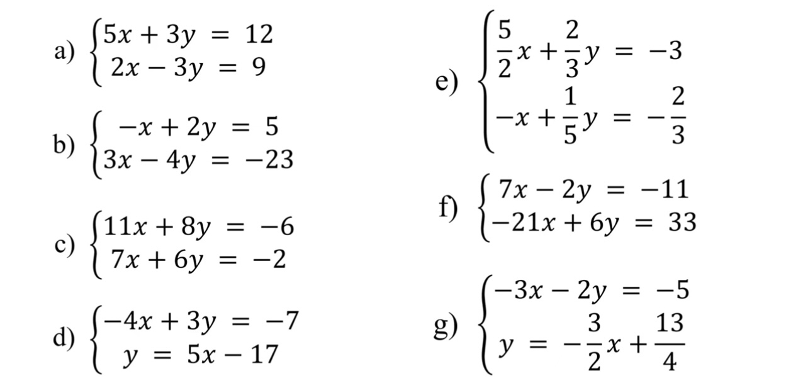
More exercises

